Slide 1
Music Recommender System

Slide 2
Ever Thought, How Applications like Netflix,Youtube,Amazon,spotify provide us Relevant stuff of what we are searching for??? It’s because of …….
Recommender Systems
The goal of a recommender system is to generate meaningful recommendations to a collection of users for items or products that might interest them.
Suggestions for books on Amazon, or movies on Netflix, are real-world examples of the operation of industry strength recommender system

Slide 3
Types of Recommender System
Recommender
System
Collaborative
Filtering
Model Based
Memory Based
Content
Based

Slide 4
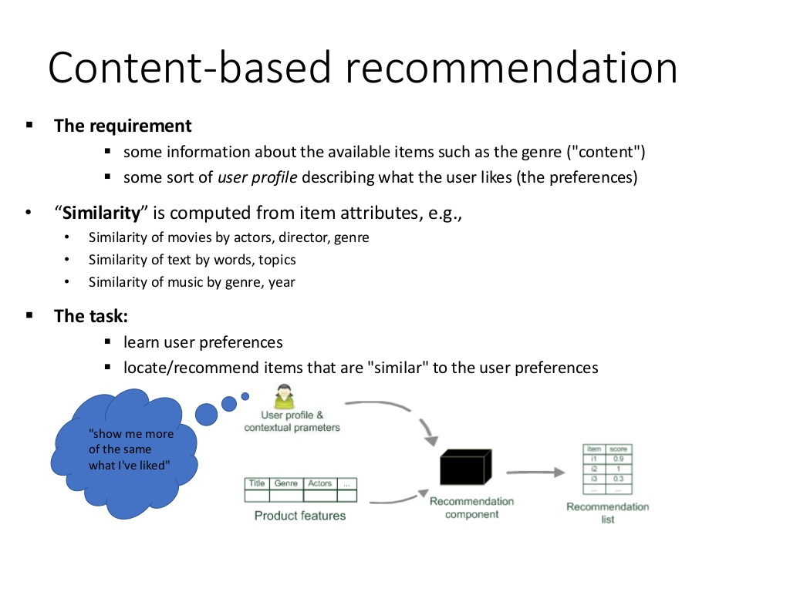
Content Based Recommendations

Slide 5
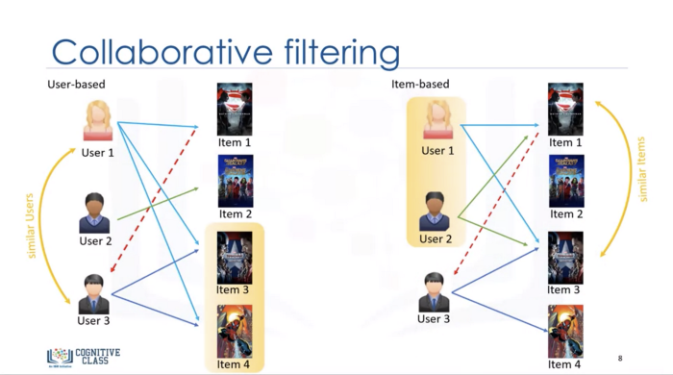

Slide 6
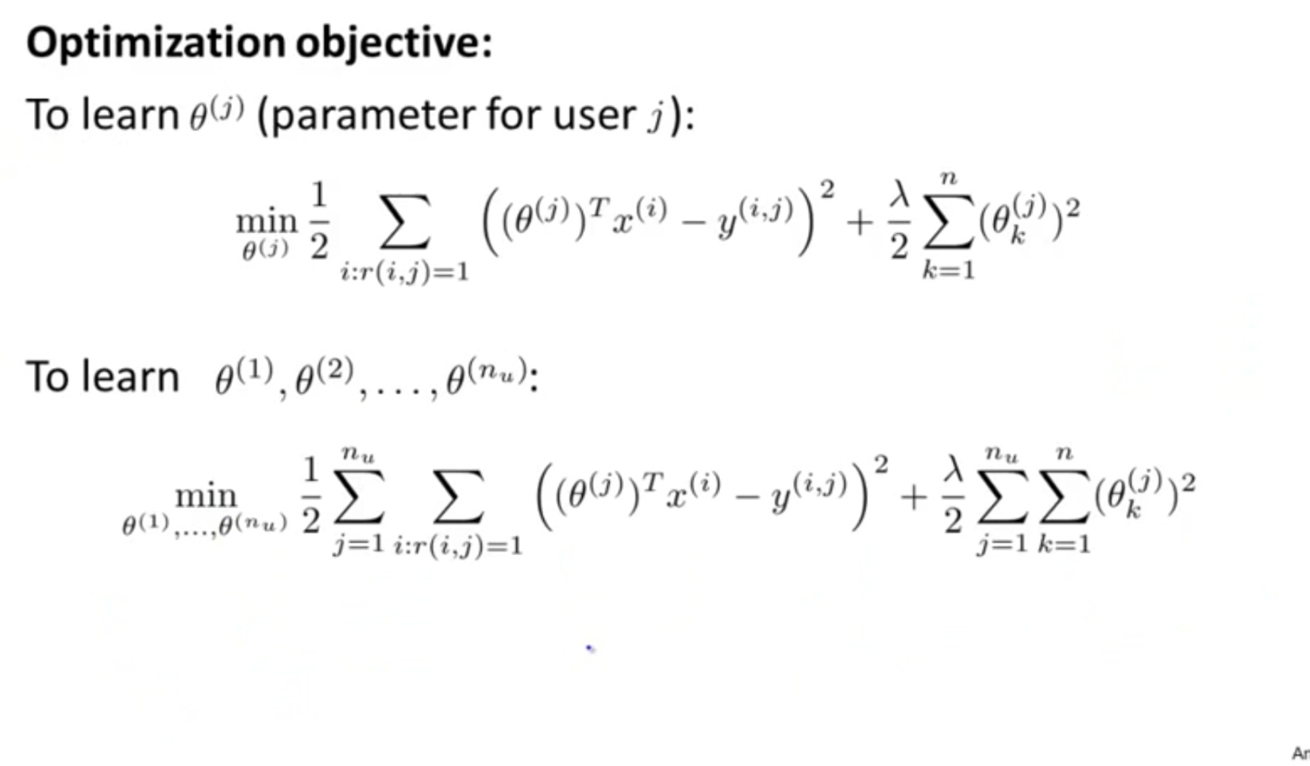
CONTENT BASED FORMULA

Slide 7
Using Music Album Information
Amy liked songs of Bahubali ConsiderRecommendations
Hero of the Movie is Prabhas → * Mirchi Movie Songs
Classified in the genre of romantic → *Romantic Songs
Music Director is MM Keeravani → * MM Keeravani Songs
This Technique is called Content Based Filtering

Slide 8
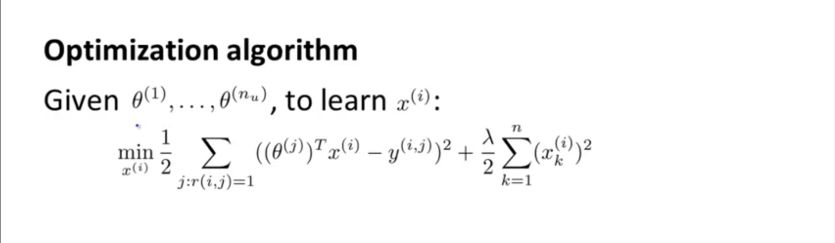
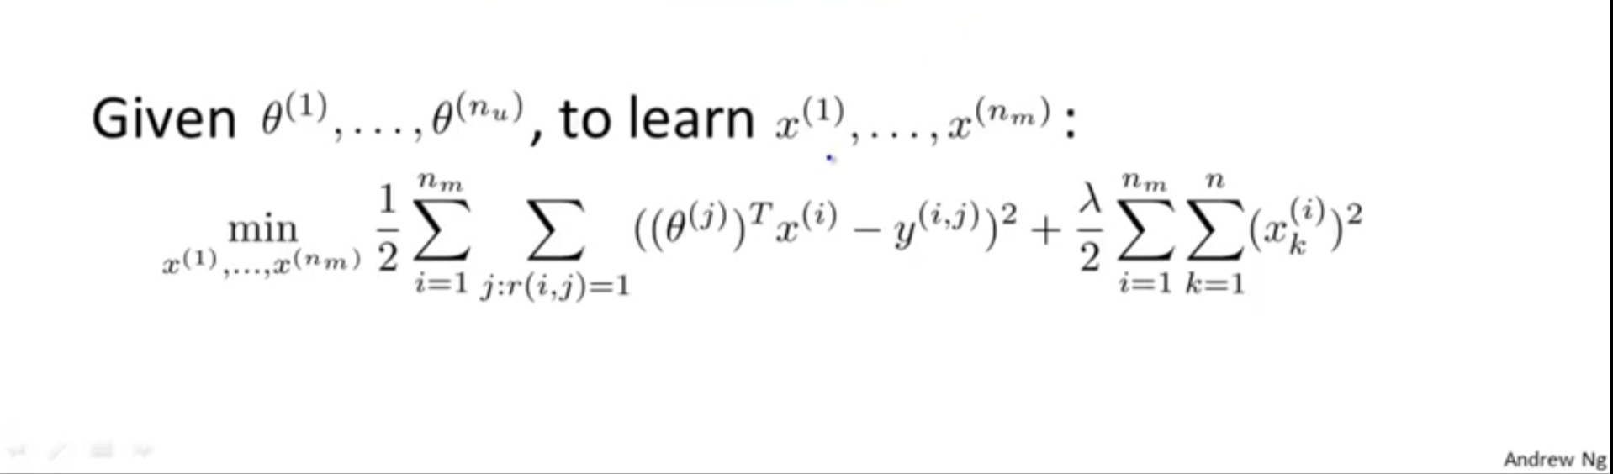
COLLABORATIVE FILTERING FORMULA

Slide 9
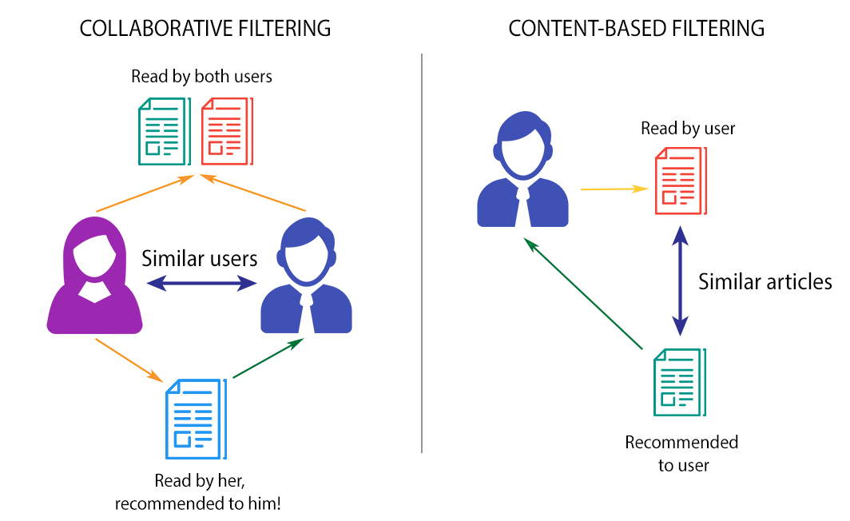

Slide 10
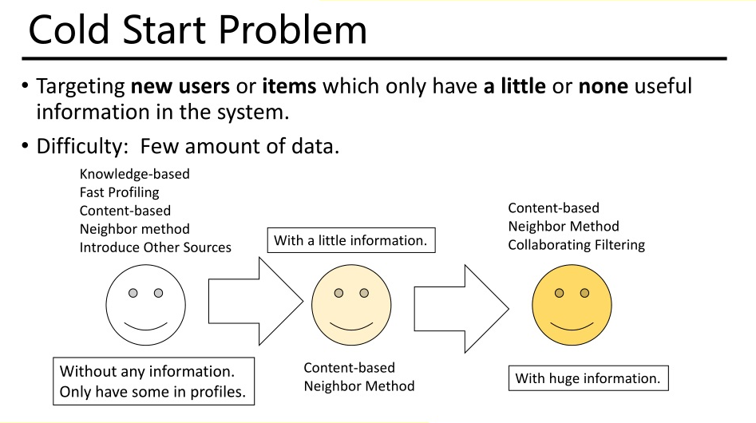

Slide 11
For cold start problem, Recommender systems make use of two different types of feedback (input). The most convenient is the high quality explicit feedback, that consists of an explicit preference given by a user for a given item. Often explicit feedback is collected via a star rating system. However, this kind of (precious) feedback is not always available (only few user give explicit feedback for items they have purchased) so recommender systems have to infer user preferences from the far more abundant implicit feedback.
SOLUTION TO COLD START PROBLEM : IMPLICIT AND EXPLICIT FEEDBACK

Slide 12
In an implicit model, once the user has given consent to collecting usage data, no additional explicit feedback action (e.g. ratings) is required on the user's side.
Implicit feedback includes purchase history, browsing history, search patterns, etc. For example, a user that purchased many books by the same author probably likes that author.

Slide 13
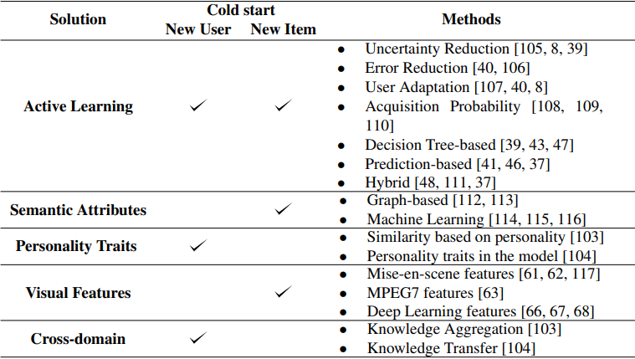

Slide 14
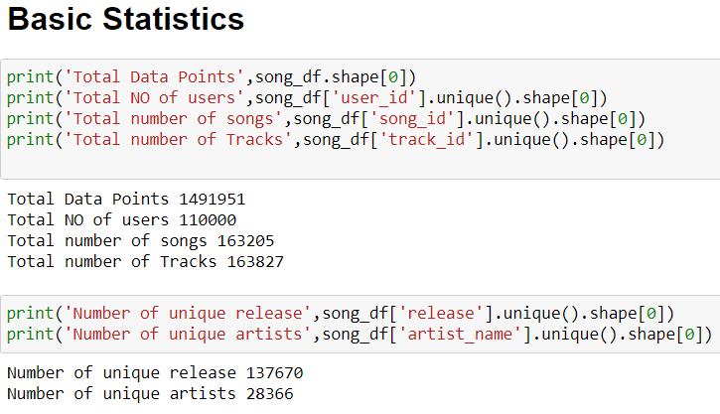
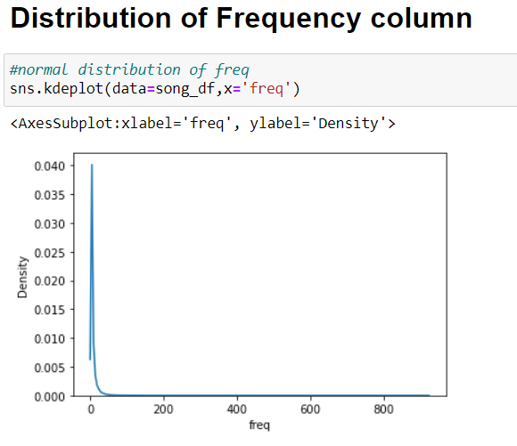
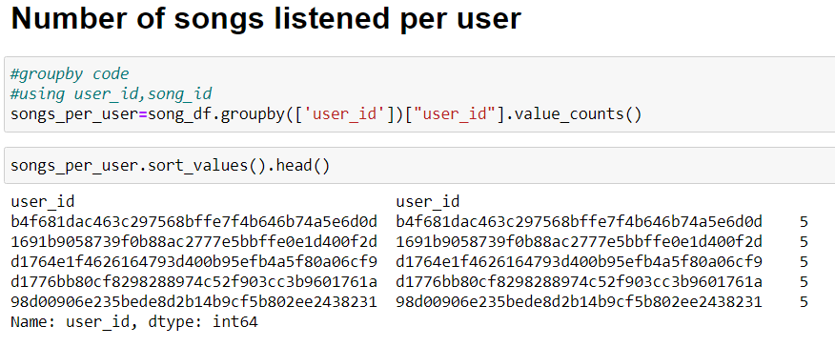
Explorative Data Analysis on the Dataset

Slide 15
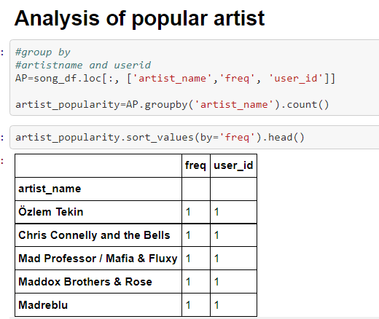
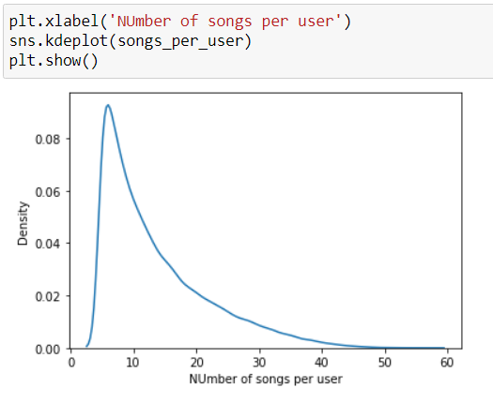
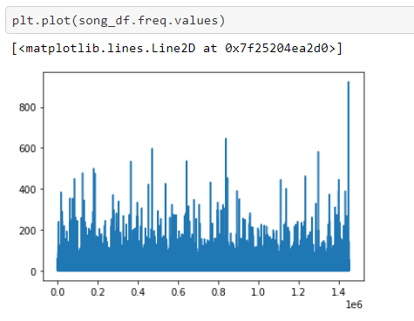
EDA (contind)

Slide 16
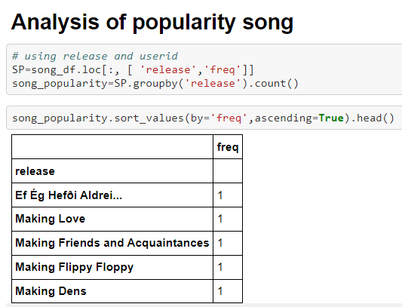
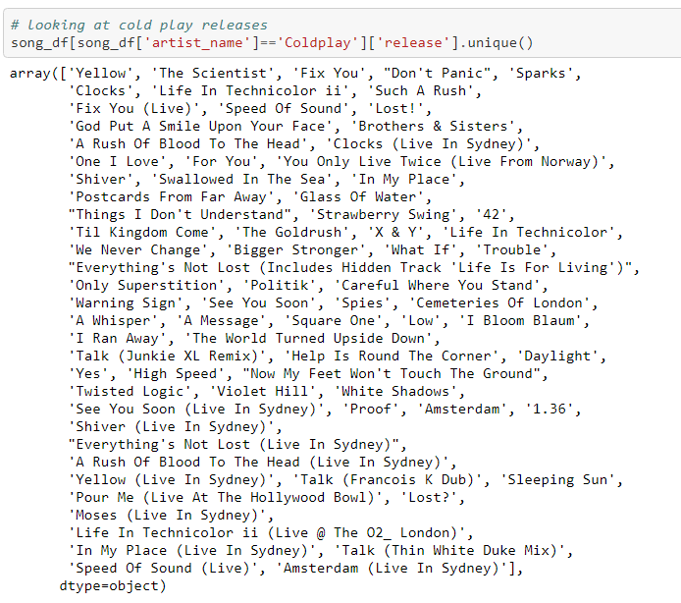
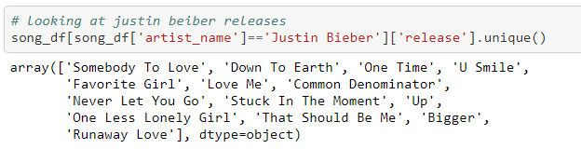

Slide 17
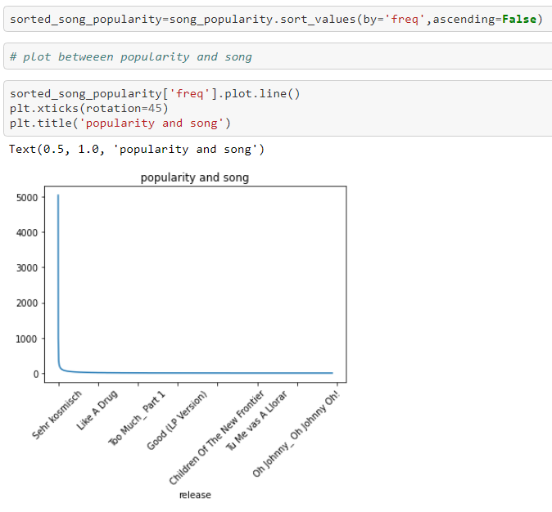
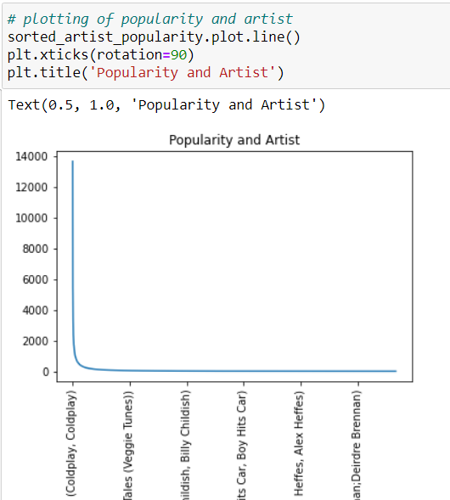

Slide 18
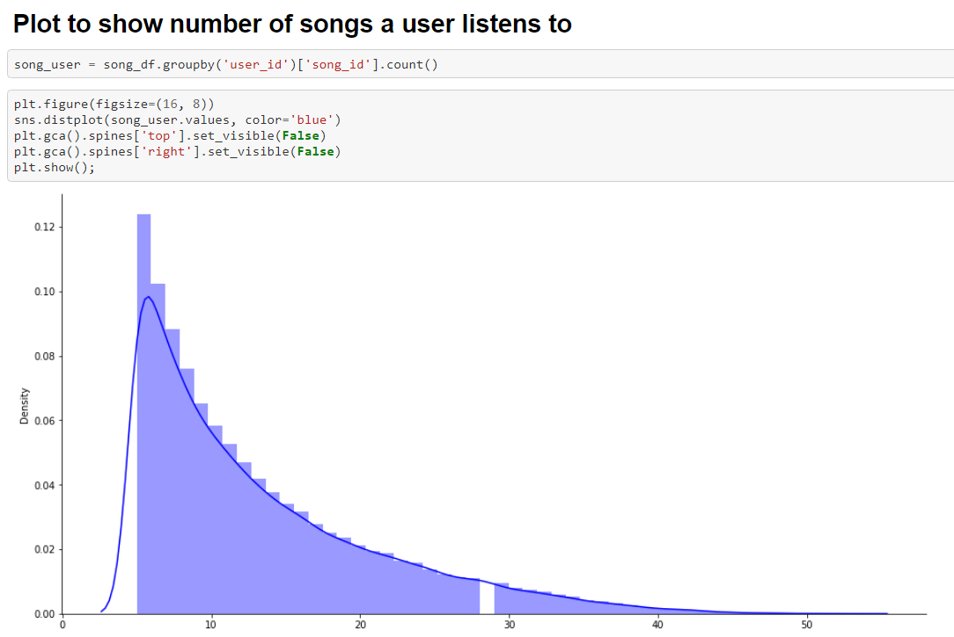
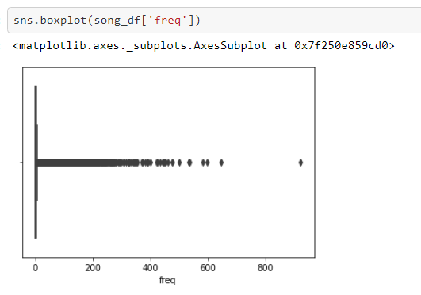
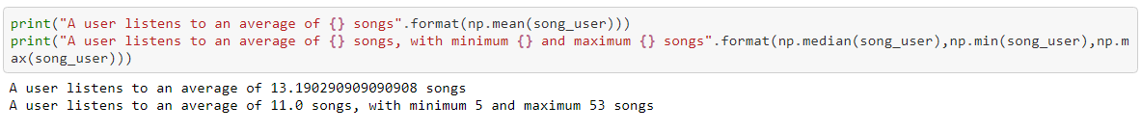
EDA (CONTND..)

Slide 19
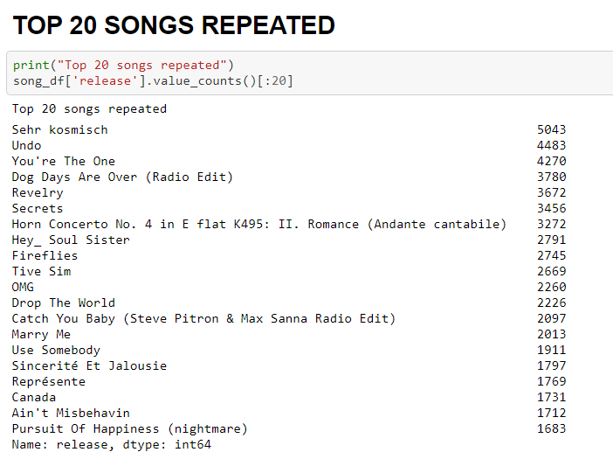
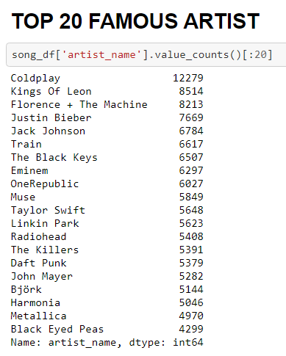
EDA (CONTD..)

Slide 20
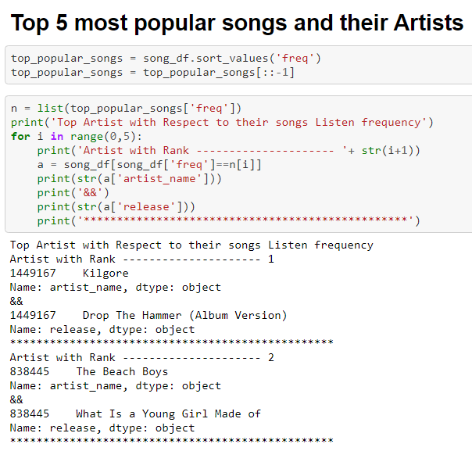

Slide 21
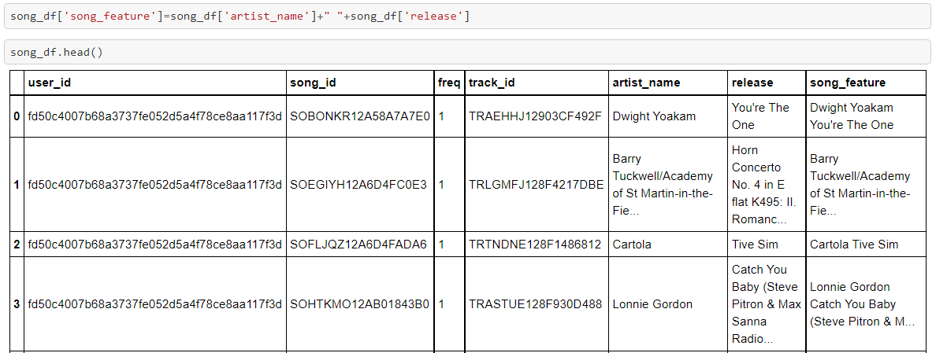
Data Preprocessing

Slide 22
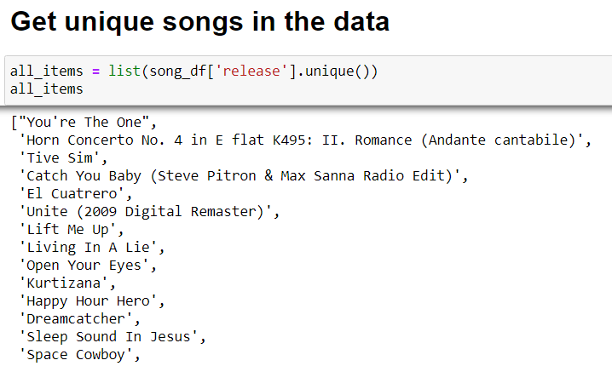
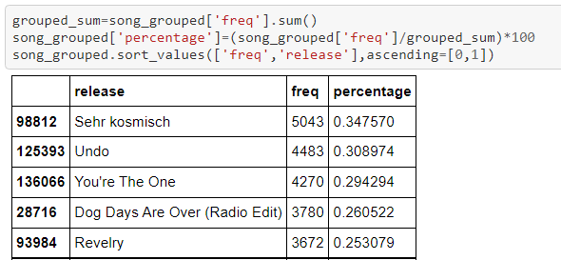
Data Preprocessing (contnd..)
Percentage of Frequency

Slide 23
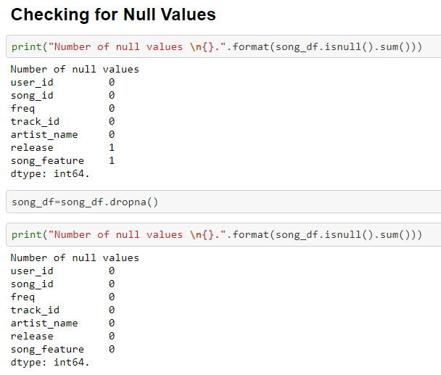

Slide 24
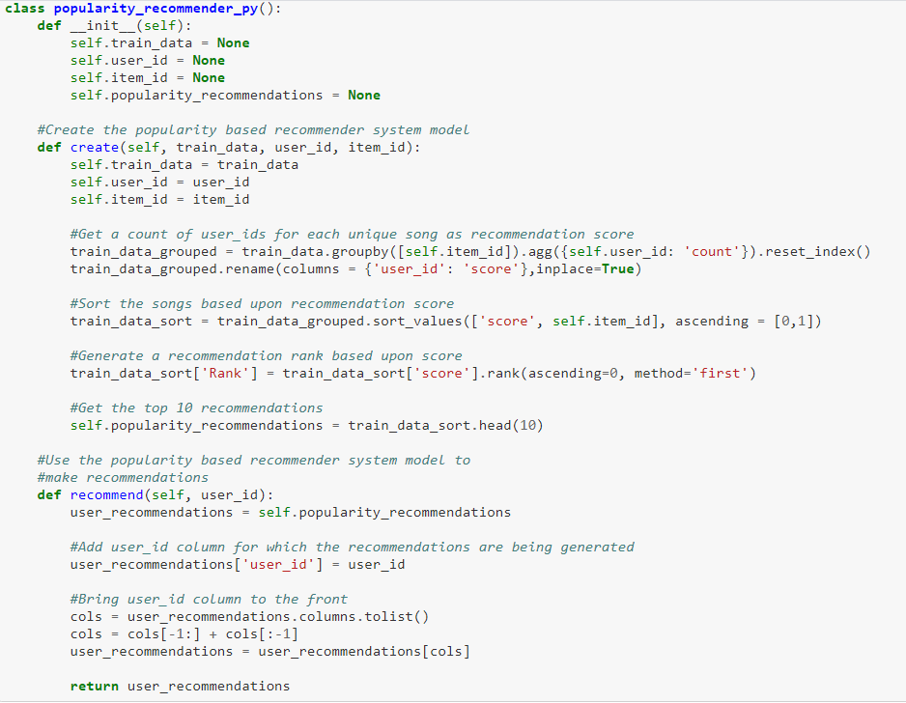
Popularity Based Recommender System

Slide 25
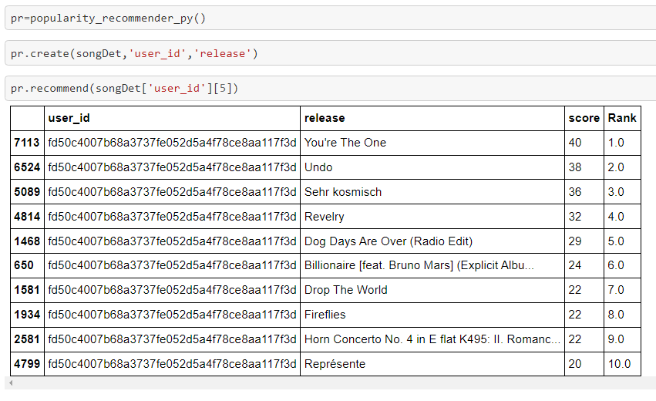
Popularity Based Recommendation (contnd..)
Hey Innominion, These are the most popular songs in trending right now, listen to it and follow the trend….☺ ☺☺
Innominion: I don’t follow the trend , I set the Trend ☺

Slide 26
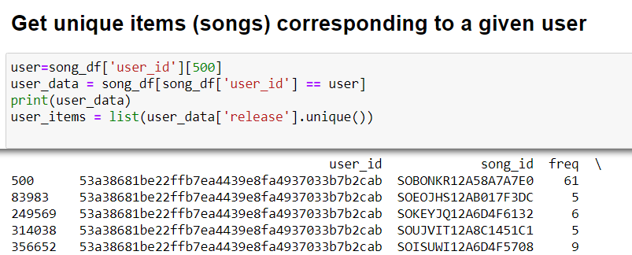
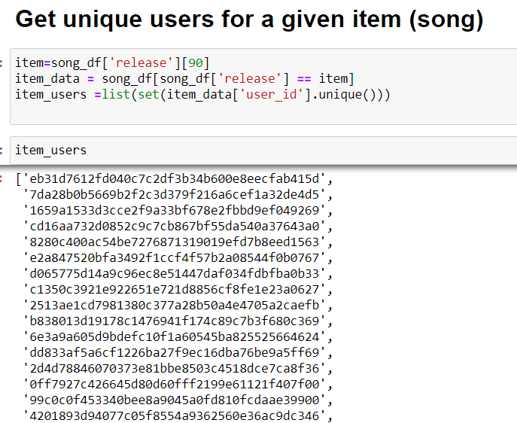
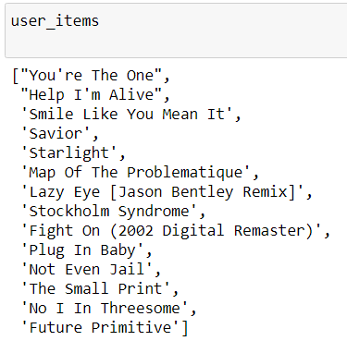
Item – Item Similarity Recommendation ( Collaborative Filtering)

Slide 27
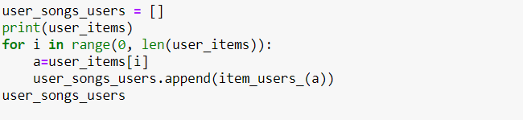
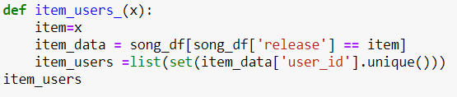
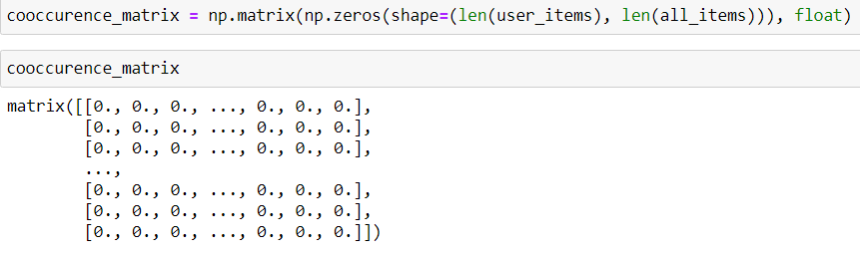
Item – Item Similarity Contnd..

Slide 28
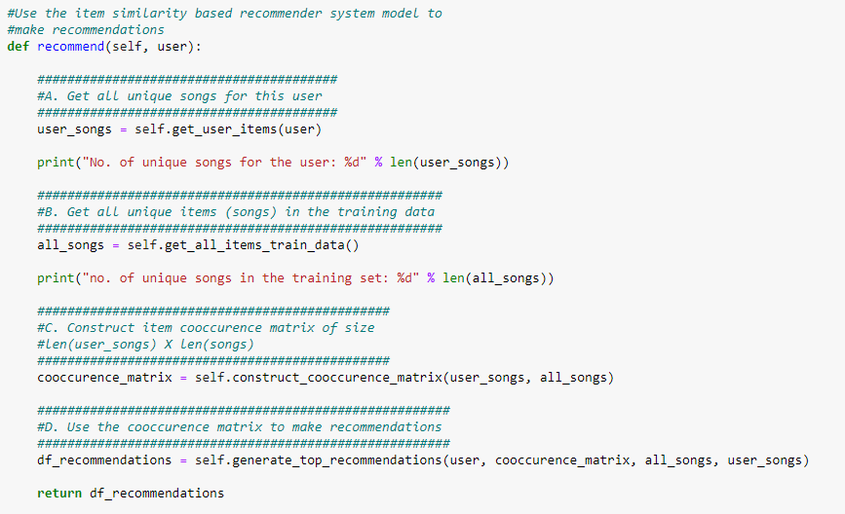
Item – Item Similarity Contnd..

Slide 29
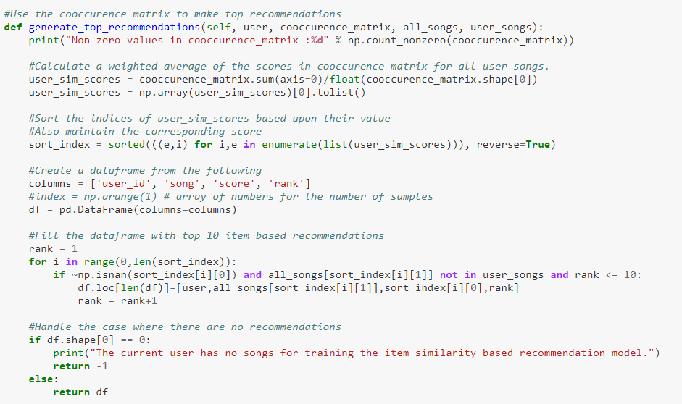
Item – Item Similarity Contnd..

Slide 30
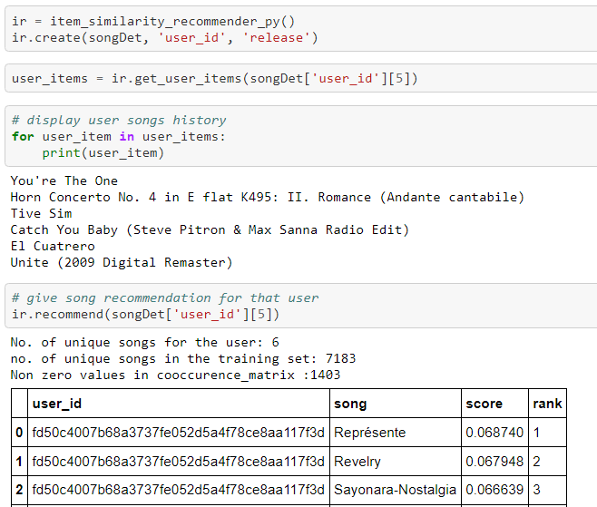
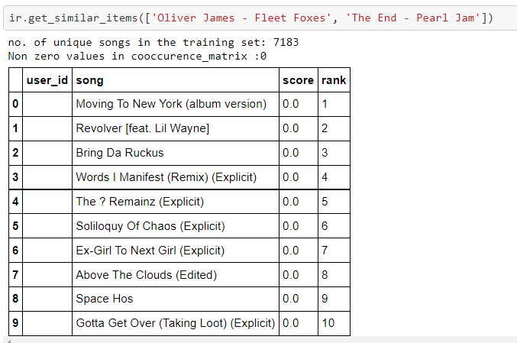

Slide 31
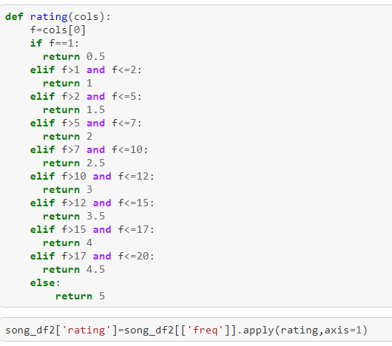
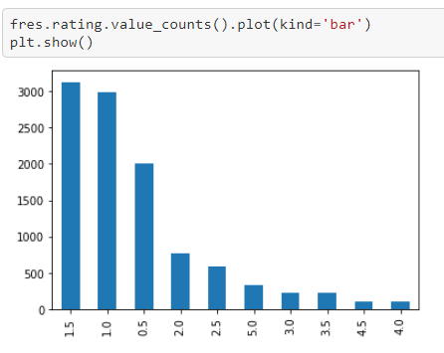
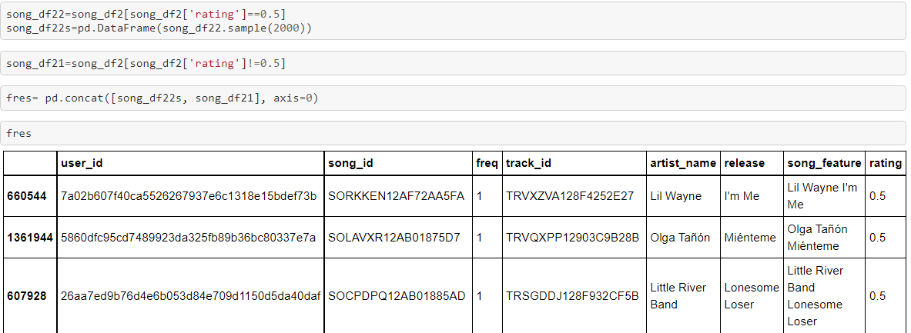
User Based Collaborative Filtering

Slide 32
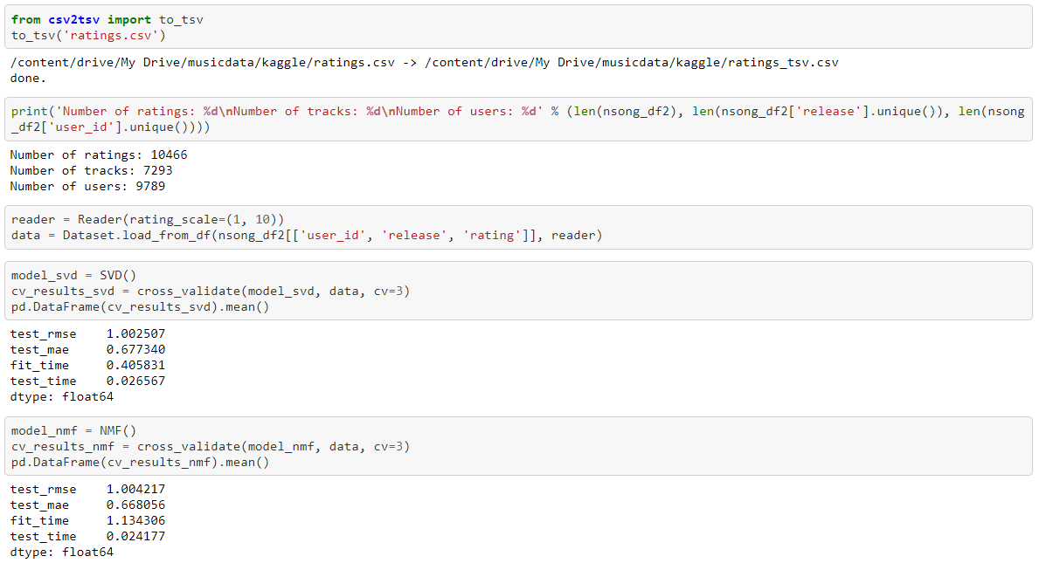

Slide 33
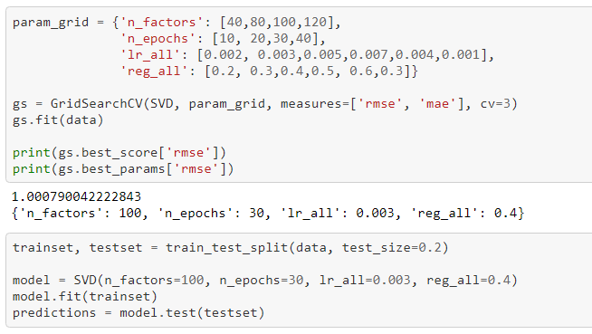
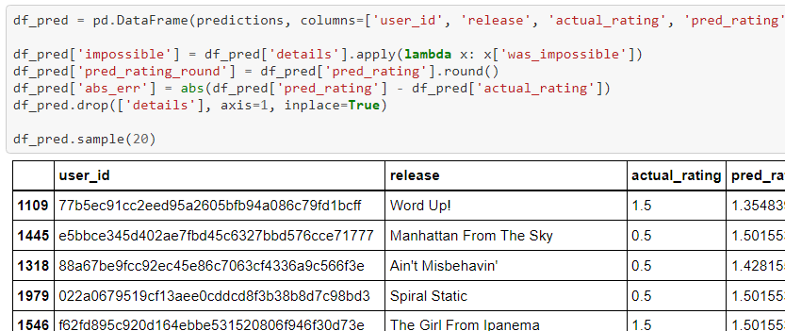
User Based Contnd..

Slide 34
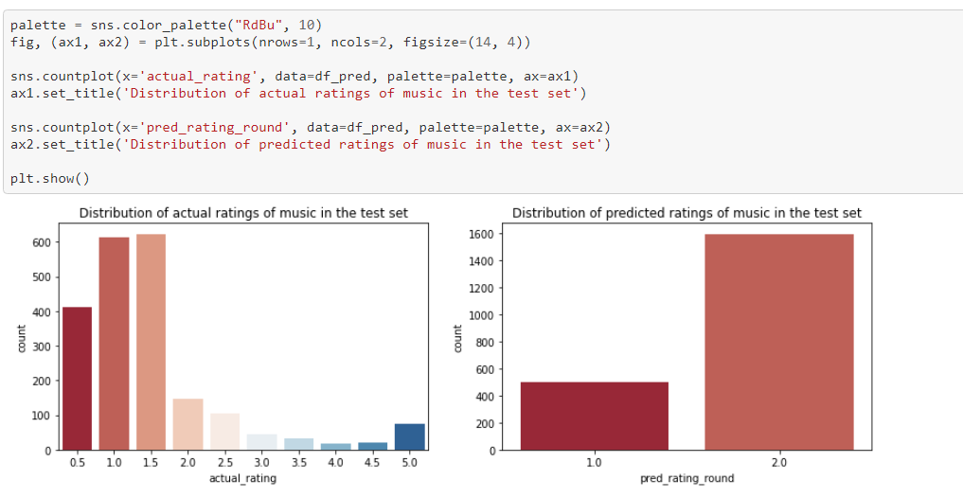
User Based contnd…

Slide 35
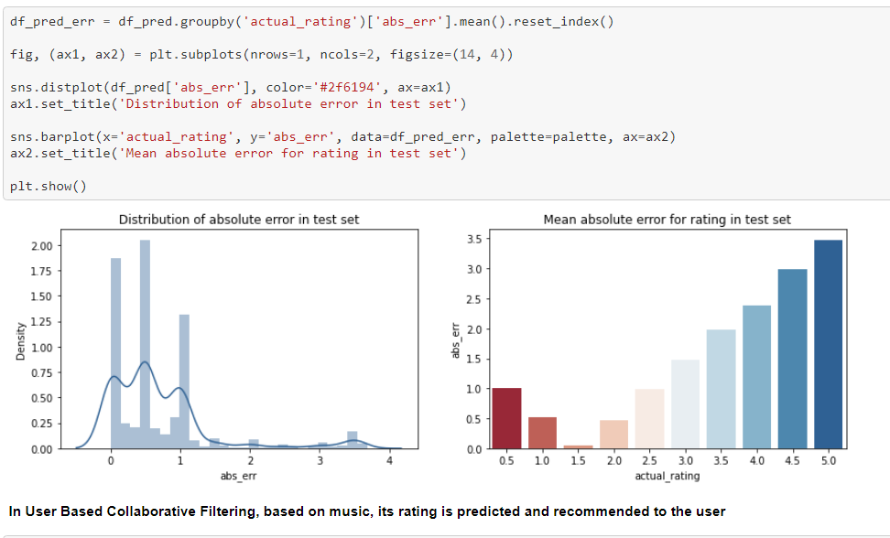
User Based contnd…

Slide 36
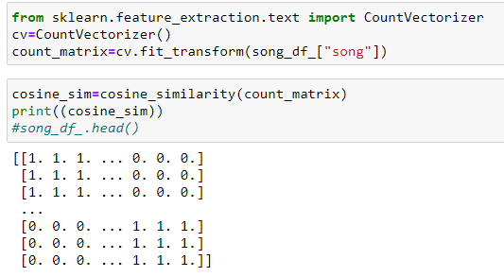

Content Based Filtering

Slide 37


Contend Based Filtering (contnd..)

Slide 38

THANK YOU

